Slide 1

Overview of Laravel (30 minutes)

Slide 2

PHP
Laravel

Slide 3
Github Repository
https://github.com/jvlcode/laravel-workshop

Slide 4
Shortcut Keys
Ctrl + A - Select All
Ctrl + C - Copy
Ctrl + V - Paste
Ctrl + S - Save
Ctrl + ` - Open/Close Terminal

Slide 5
Setting Up Environment
Installing XAMP Server (Cross-Platform, Apache, MySQL, PHP)
Start the Apache & MySQL services

Slide 6
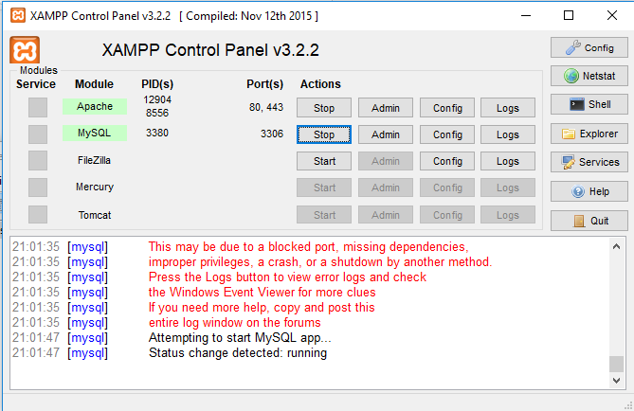
Check PHP is Working

Slide 7
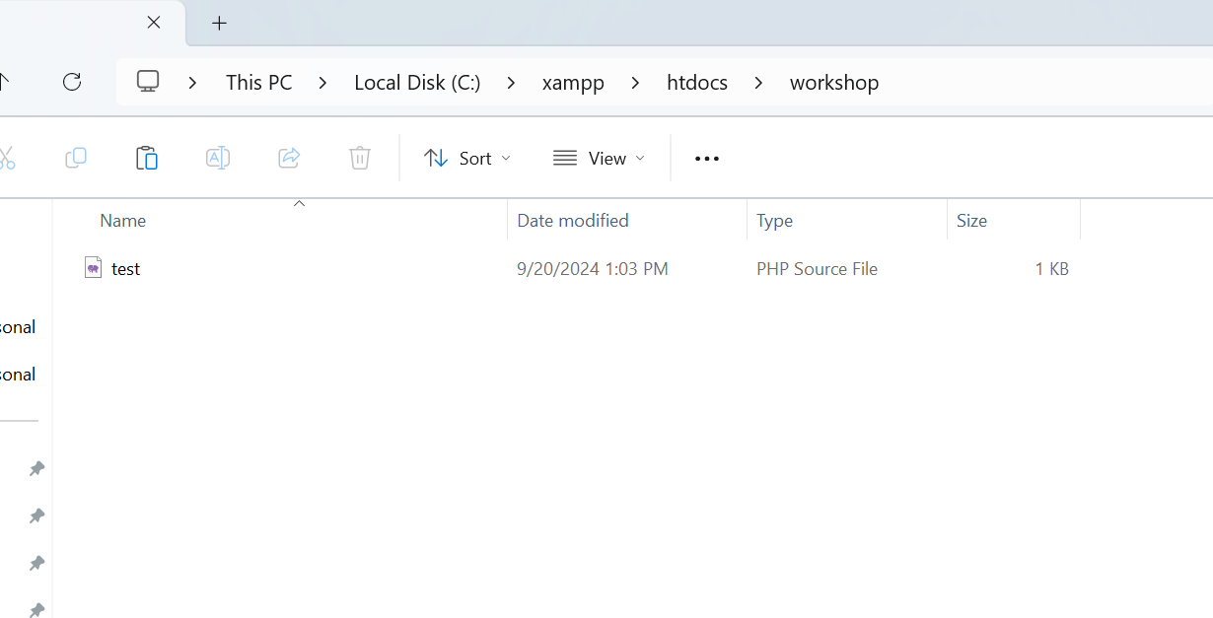
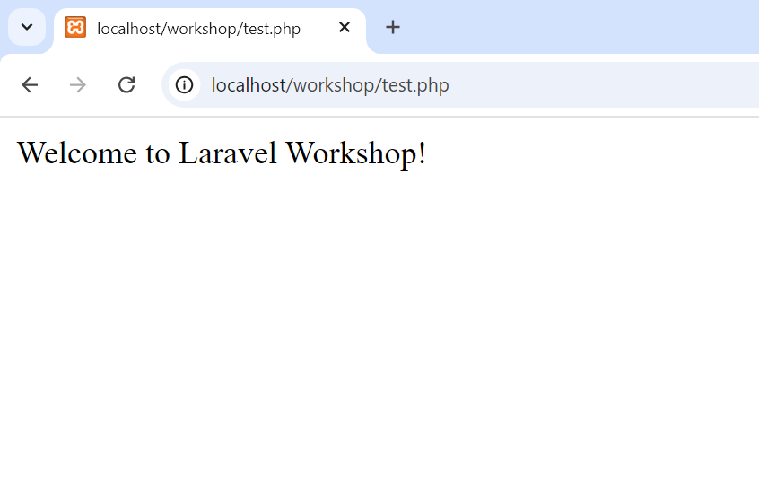
Check PHP is Working
Copy and Paste “test.php” in htdocs/workshop
open “http://localhost/workshop/test.php”
We need to put php files only in htdocs. This is the Apache web server folder

Slide 8
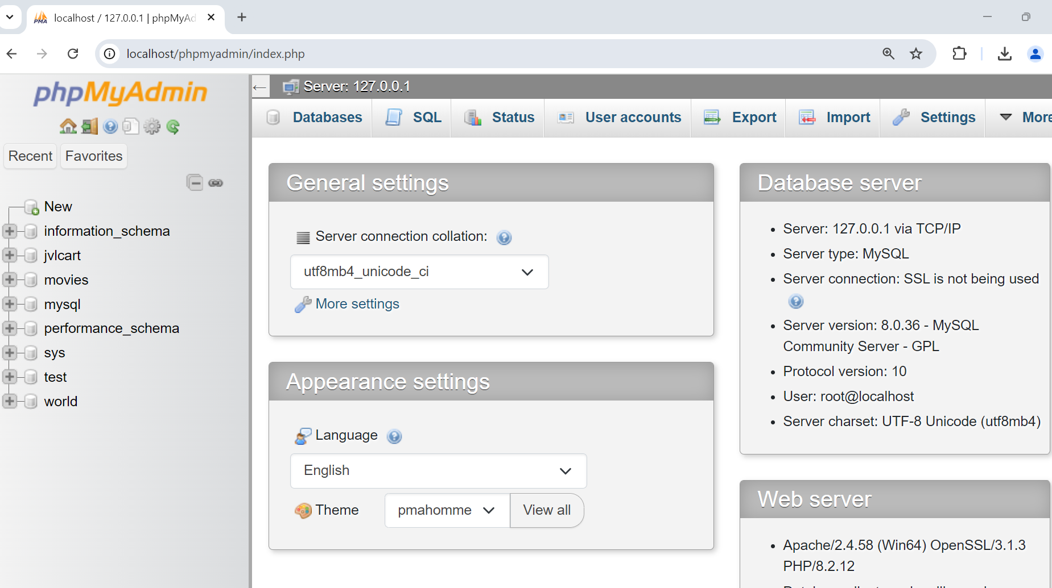
Check PHPMyAdmin is Working
open “http://localhost/phpmyadmin”

Slide 9
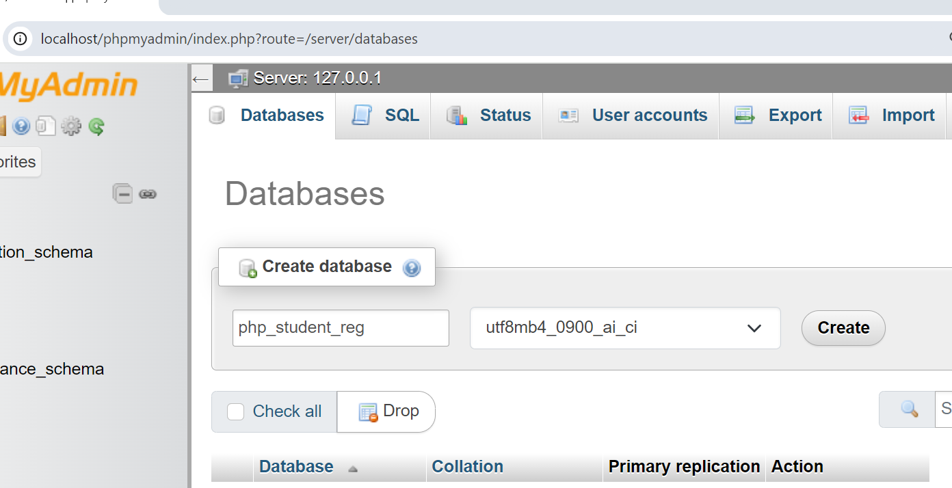
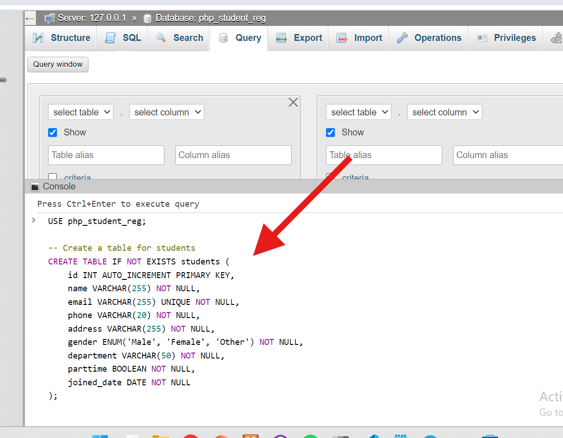
PHP Project
(without framework)
Copy the Sql from “student_reg.sql”
and submit query in phpMyAdmin
to create tables
Create “php_student_reg” database in phpmyadmin

Slide 10
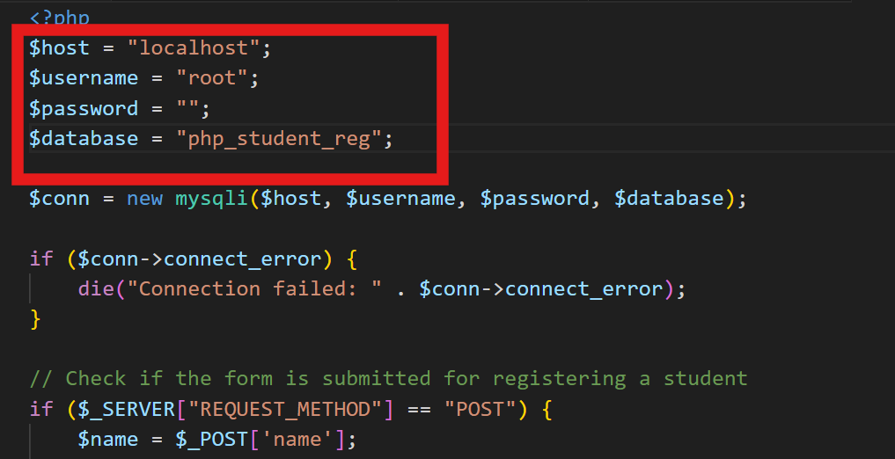
PHP Project
(without framework)
Download and Place register.php file in htdocs/php_student
Open student folder in VScode and Update DB details

Slide 11
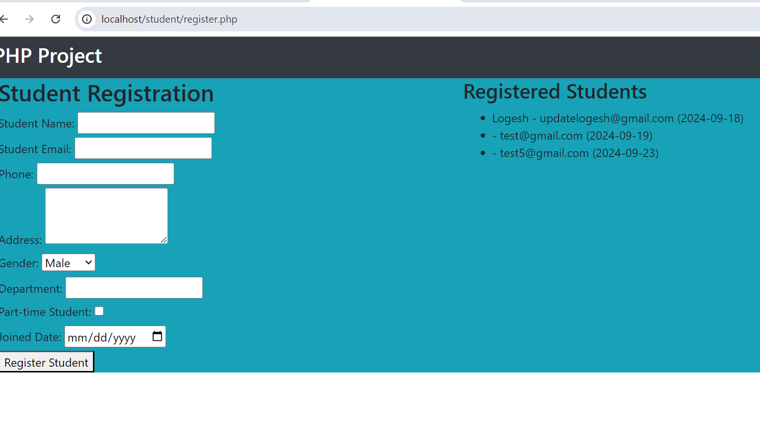
PHP Project
(without framework)
Open http://localhost/php_student/register.php

Slide 12
PHP Project Problems
(without framework)
Difficulty in Managing View and Function code
Writing SQL queries for database operations
Submit Data From Outside for Hacking
Exposing Database Credentials
Security

Slide 13
Overview of Laravel (30 minutes)

Slide 14
PHP web application framework
Developed by Taylor Otwell,
It follows the MVC architectural pattern.

Slide 15
Model-View-Controller
Webpage
Webpage
Model (database code)
Database code
Function code
Controller (function code )
Design code
View (design code )

Slide 16

Why Choose Laravel?
Eloquent ORM for database interaction.
ORM stands Object Relational Mapping
Maps objects to database
Laravel App
Eloquent ORM
Obj 1
Obj 2
No complex SQL queries
Database
Different Database Support

Slide 17
Why Choose Laravel?
Blade templating engine for efficient views.
Layout
Home Page
Contact Page
Section 1
Menu links
Advertisement
Section 2
Articles
Address Details

Slide 18
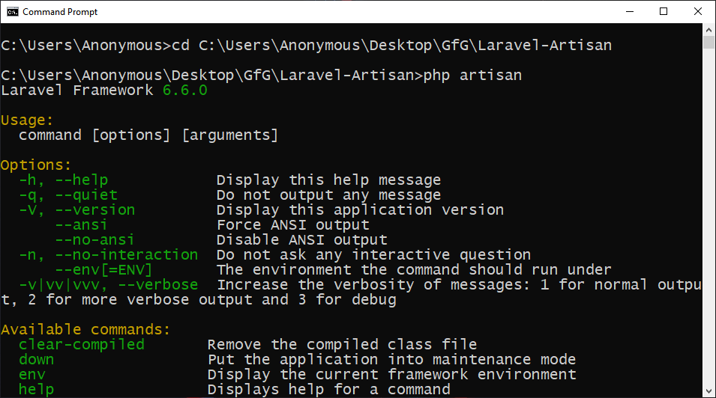
Why Choose Laravel?
Artisan CLI for faster development tasks

Slide 19
Other Features
Inbuilt Development Server – No apache required
Database Seeding – For adding Demo data
Migrations – Tracking database changes
Support for Cloud services - AWS, Email Service
Security – Testify to all your application security needs.

Slide 20


Why Choose Laravel?
Community Strength

Slide 21
Setting Up Environment
Installing PHP, Composer.
Check composer and php version in CMD
Configure zip extension php.ini (see later)

Slide 22
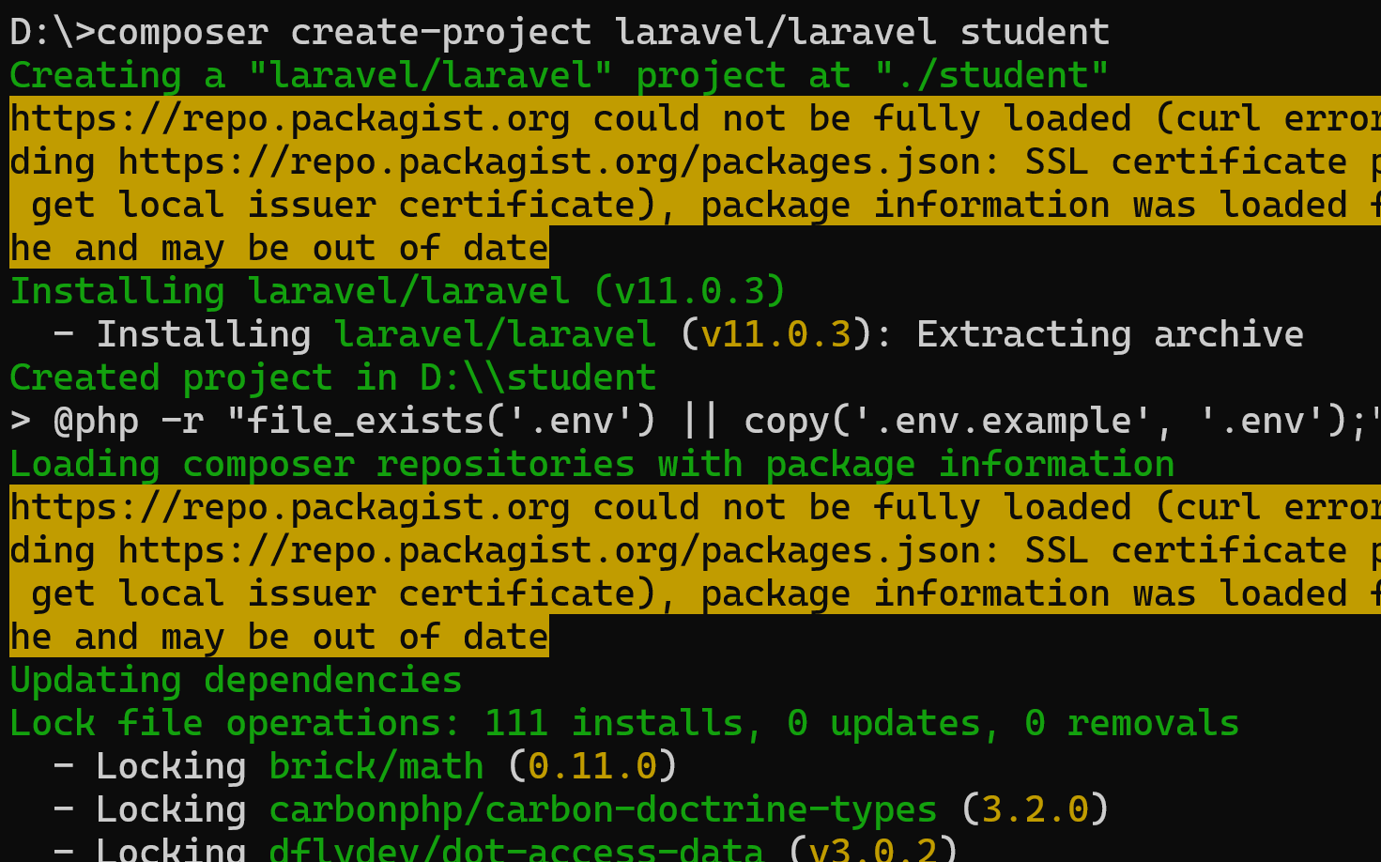
Laravel Project
Choose any folder. we don’t need htdocs folder. Laravel has inbuilt server. open command terminal. Run “composer create-project laravel/laravel student”

Slide 23
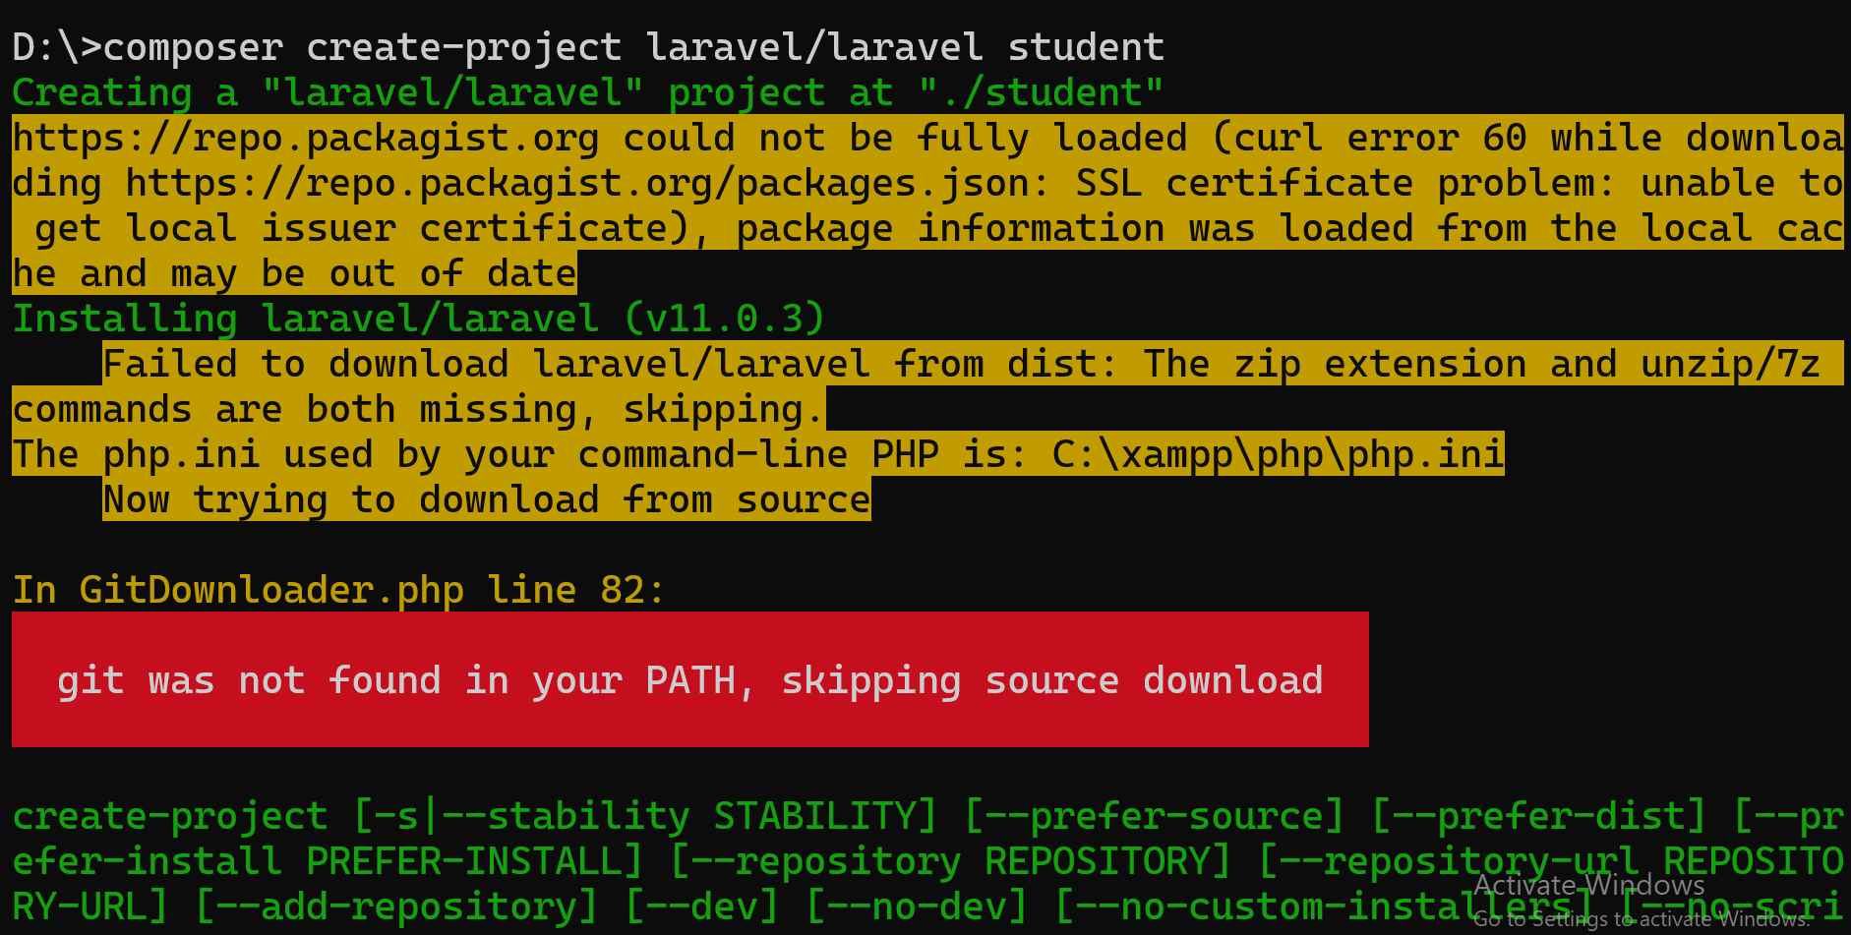
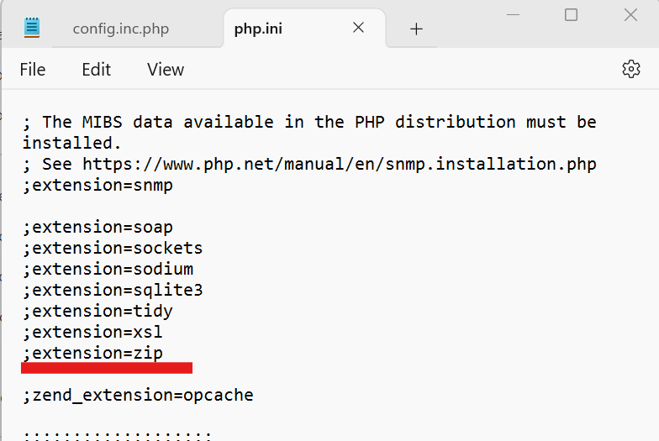
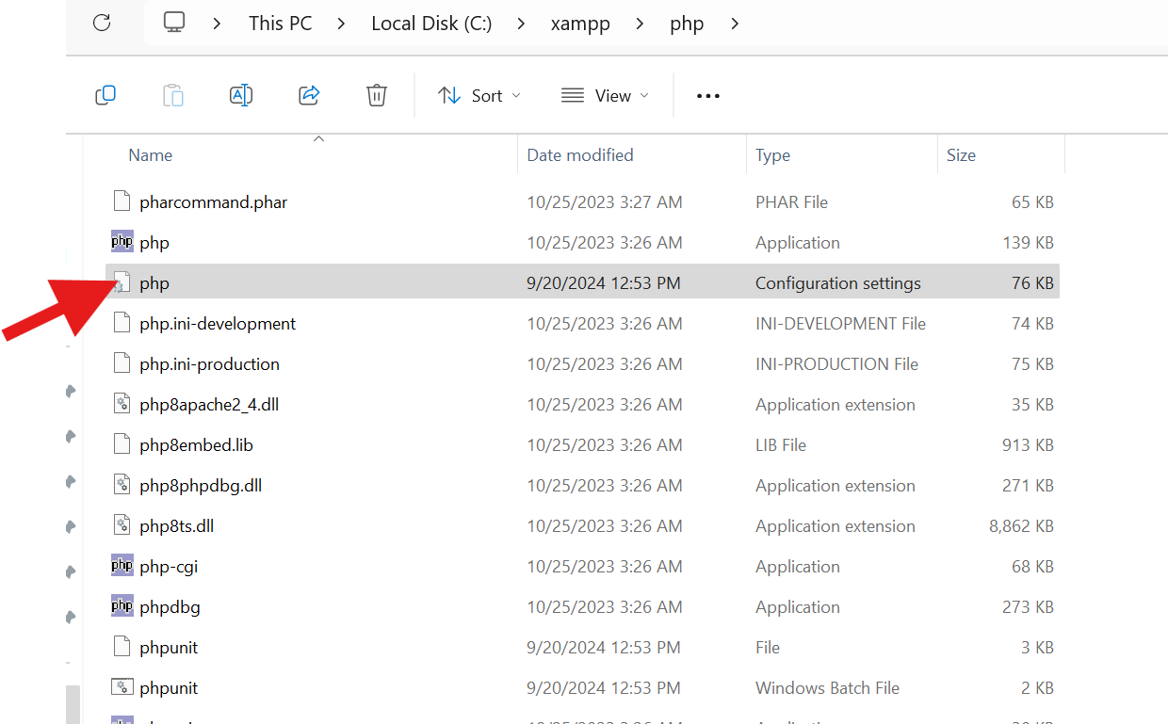
Configure Extensions
Remove ; symbol for zip , save and close

Slide 24
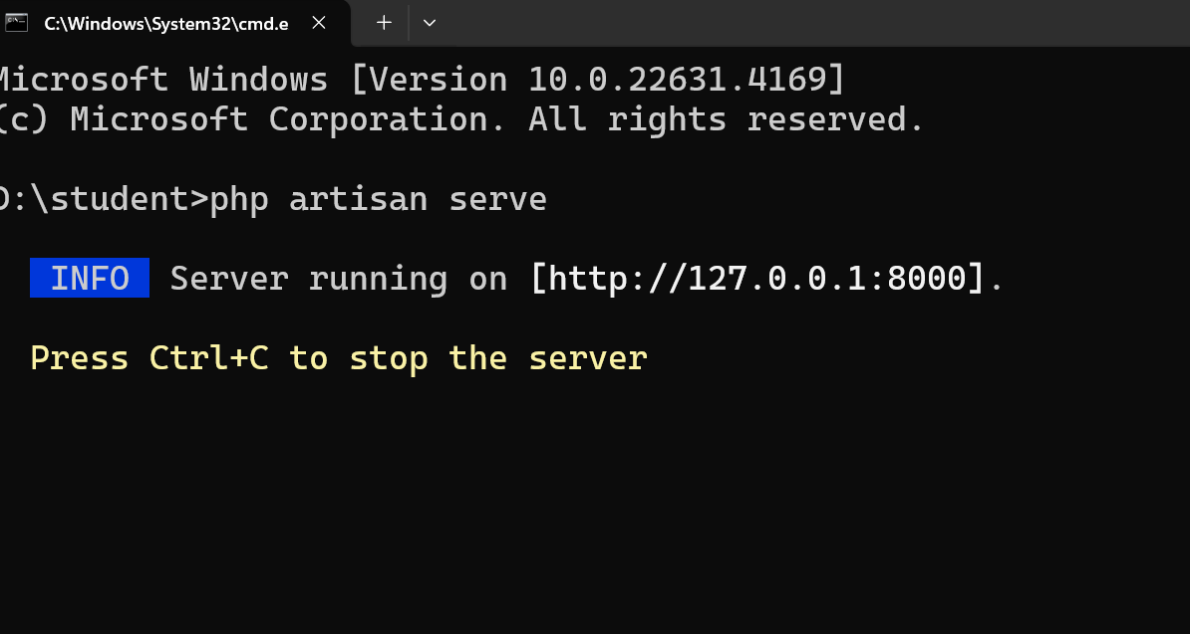
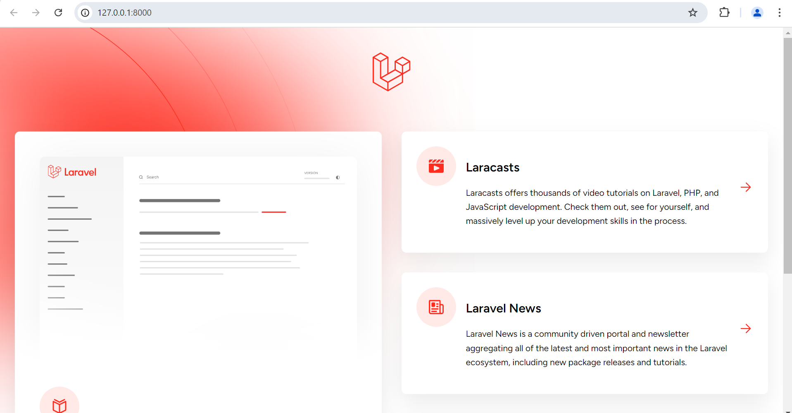
Laravel Project
Open the project in vscode
Run “php artisan serve” to run
Open “http://127.0.0.1:8000/”
to see Laravel`s welcome page

Slide 25
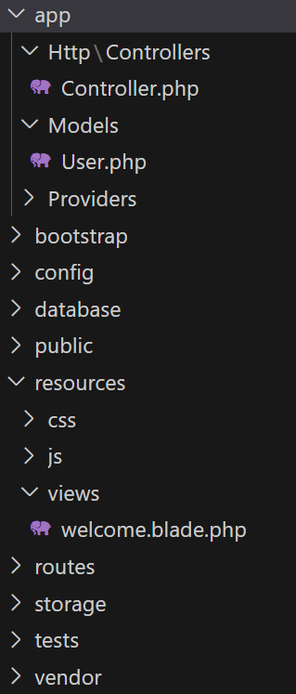
Laravel Project Structure
Function code (Controller)
Database code (Model)
MVC
View code
Routes

Slide 26


ROUTE
Route is a way to specify how your web application should respond when a user accesses a particular URL
Request
Route

Slide 27
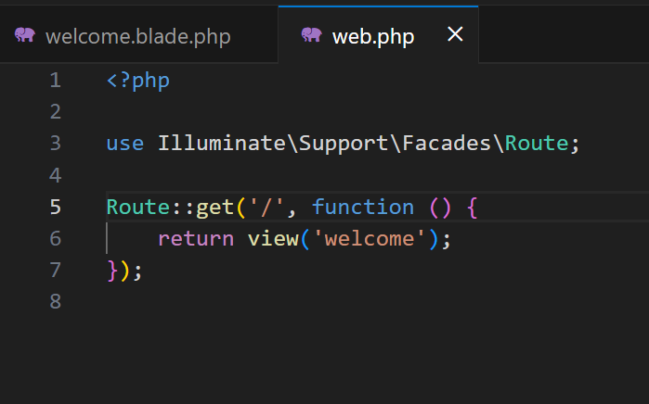
Route
URL Path
Function or Controller for handling this request
Refer: https://github.com/jvlcode/laravel-workshop/blob/main/section2/laravel_student/routes/web.php
Try creating route with “hello” path and return “Hello world” text Also create view “hello” blade and return view from route

Slide 28
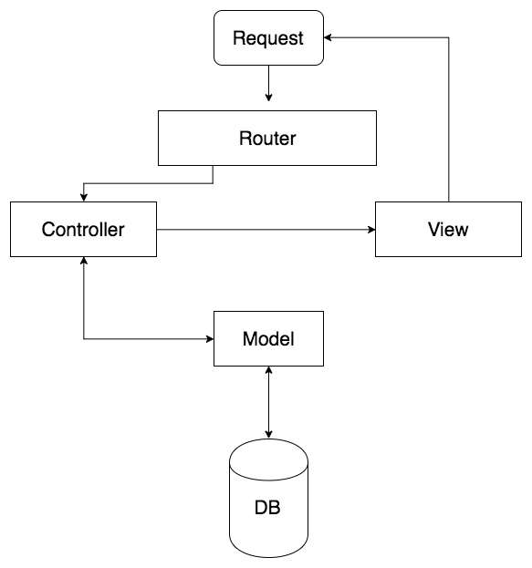



Architecture of Laravel App

Slide 29
GET ROUTE
Laravel App
GET
Route
/student-form
Controller
StudentController.php
viewForm
http://127.0.0.1/student-form
FORM PAGE
Receives Form Page as Response

Slide 30
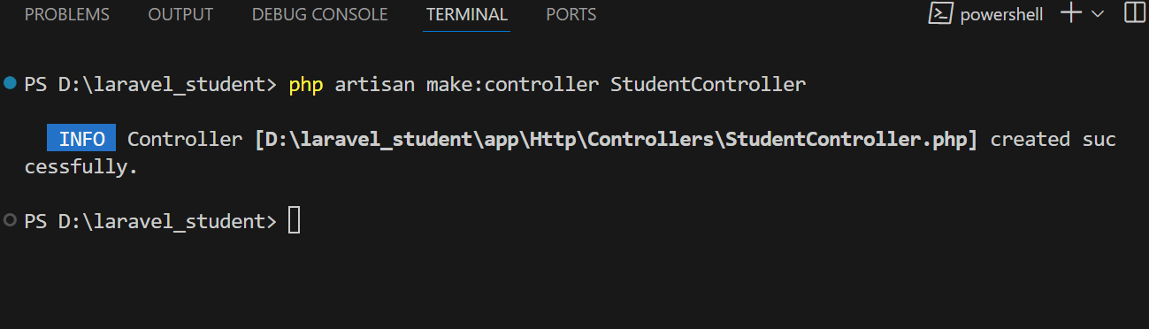
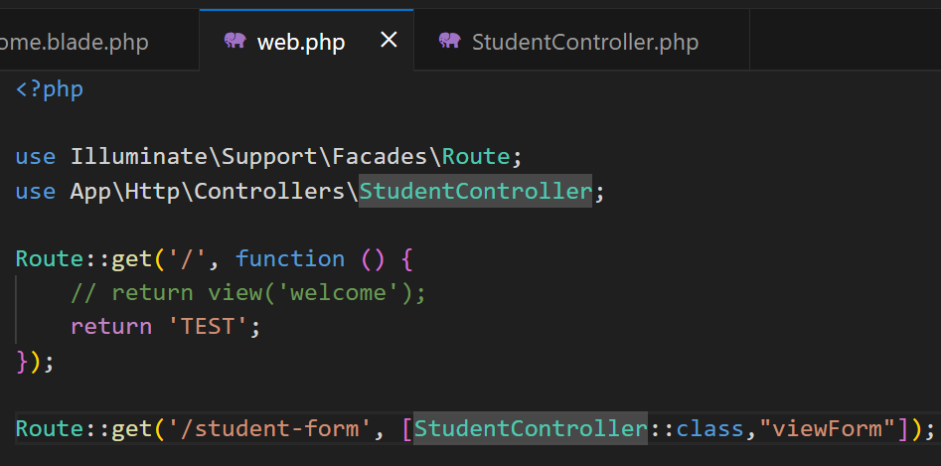
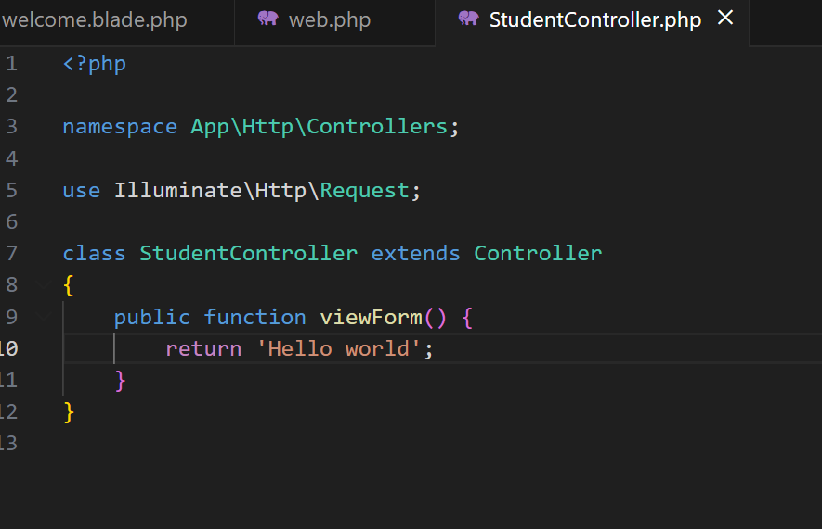
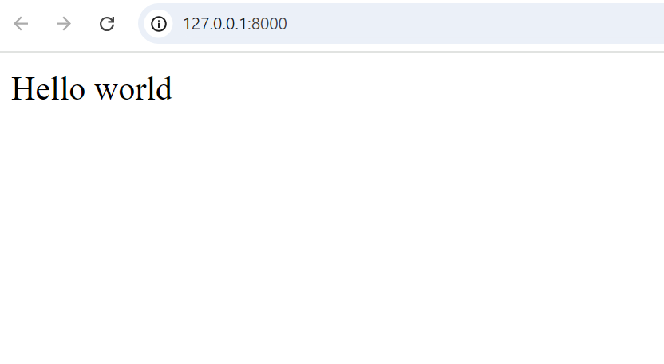
Route to Controller
Create the Controller
Add “viewForm” to the route handle this request
Add “viewForm” function

Slide 31
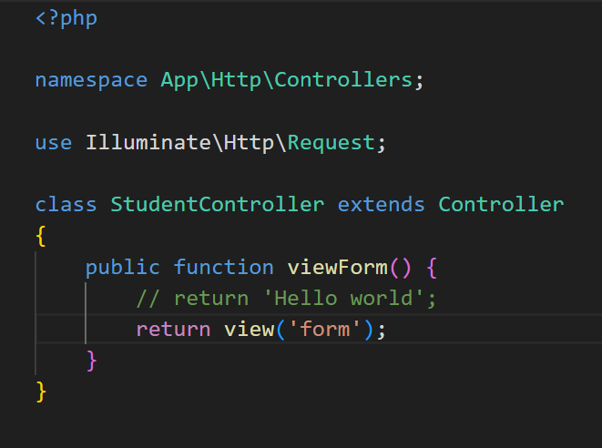
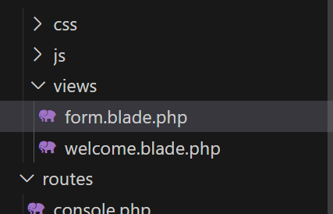
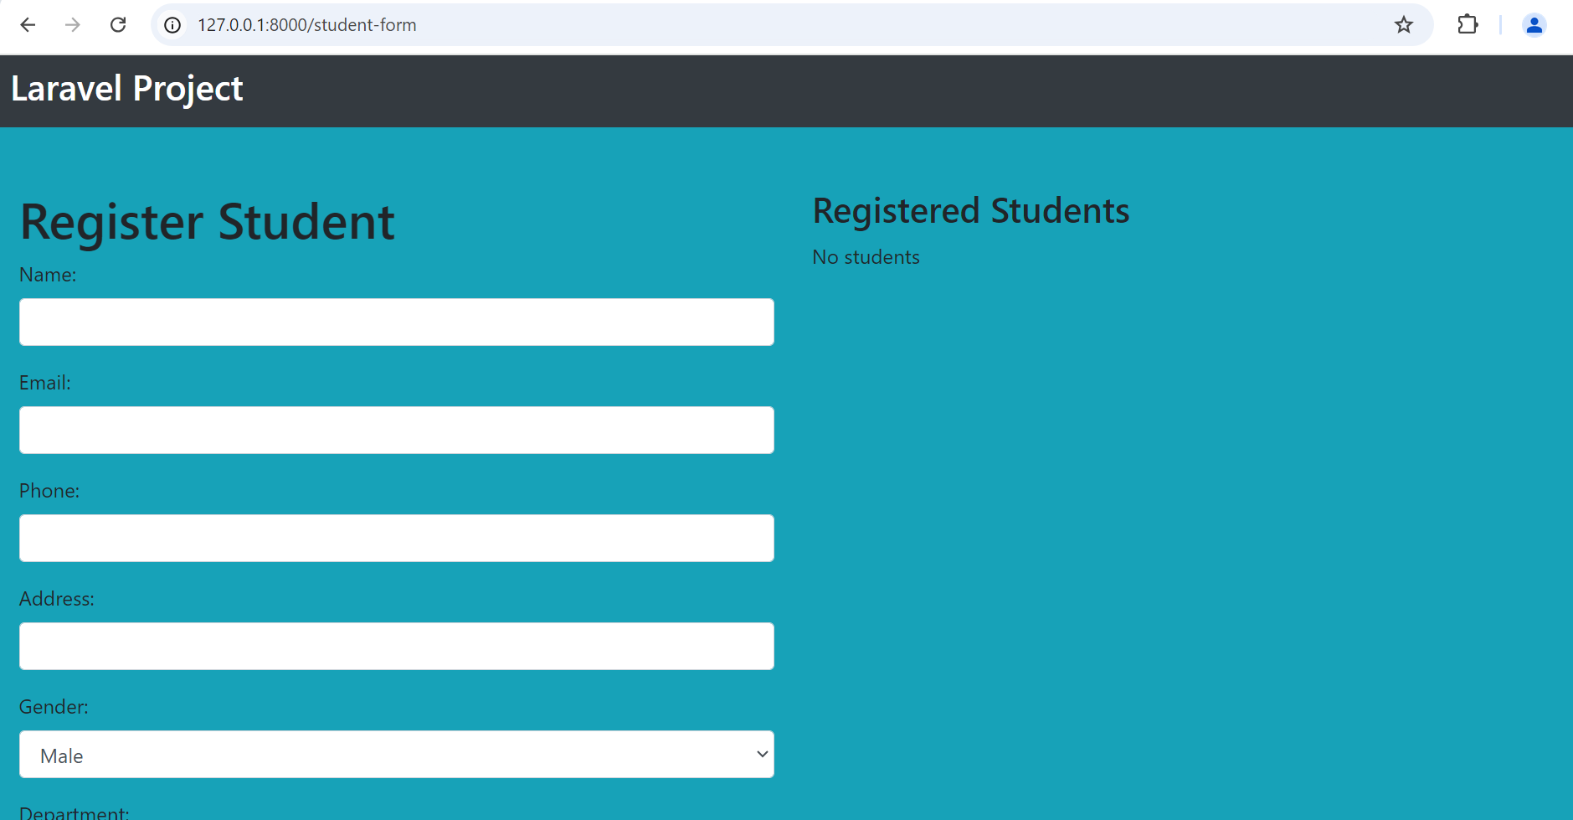
Returning a View
Return view in viewForm method
Create “form.blade.php” Add view code
Copy code :
https://github.com/jvlcode/laravel-workshop/blob/main/section2/laravel_student/resources/views/form.blade.php

Slide 32
POST ROUTE
FORM PAGE
Laravel App
POST
Route
/add-student
Controller
StudentController.php
addStudent
Form Submitted
Redirects to Form Page

Slide 33
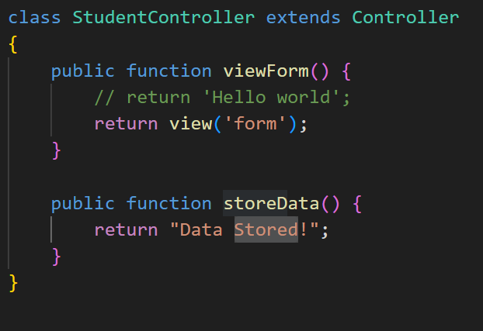
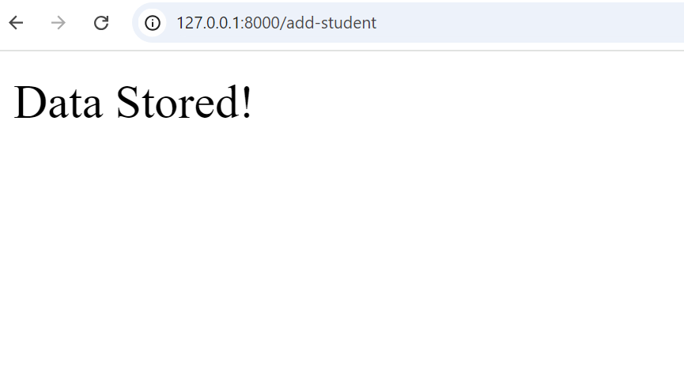
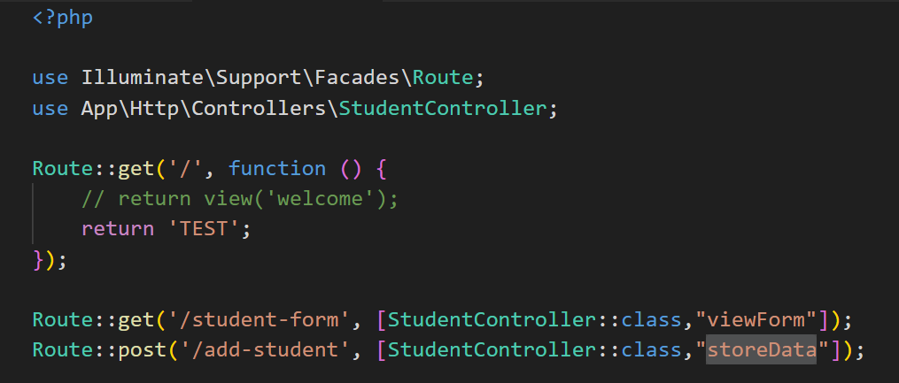
POST Request
Add “storedData”
Add POST route

Slide 34
ROUTE
Routes declared in routes/web.php
Route
/student-form
Controller
StudentController.php
viewForm
http://127.0.0.1:8000/student-form
Route
/add-student
Controller
StudentController.php
storeData
http://127.0.0.1:8000/add-student

Slide 35
ROUTE METHODS
GET
Route
/student-form
Controller
StudentController.php
viewForm
http://127.0.0.1/student-form
POST
Route
/add-student
Controller
StudentController.php
storeData
http://127.0.0.1/add-student

Slide 36
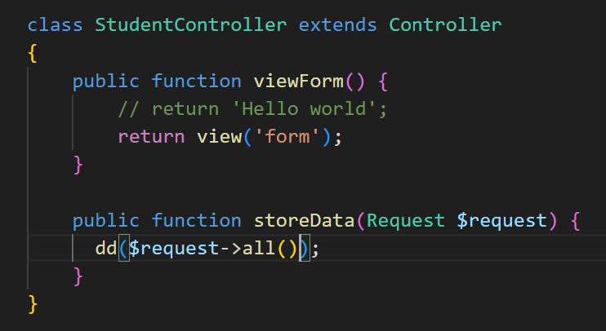
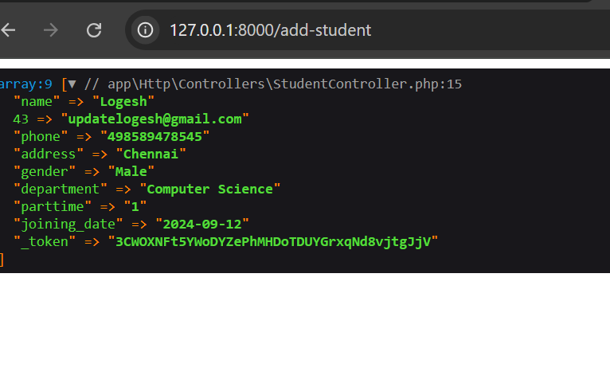
Getting Form Values
Dump all request values
See Output after submitting form

Slide 37
Database Setup in Laravel

Slide 38
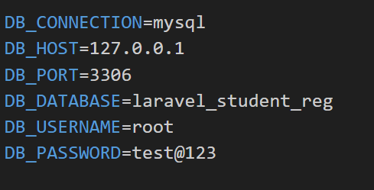
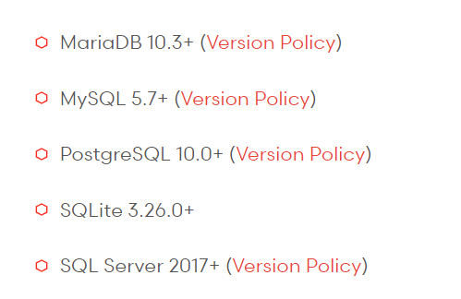
Enviroment Variables
Update DB Credentials in .env File
Database Support

Slide 39
MIGRATION
Migration
Create Students Migration
Generate Database Table
Table Column Changes
Generate Students Table

Slide 40
MIGRATION
Schema Definition: Define and version-control the structure of database tables.
Database Seeding: Populate the database with sample or default data for testing or development.
Rollback: Ability to undo or rollback database migrations in case of issues.
Database Changes in Code: Express database changes using PHP code, aligning with application code.

Slide 41
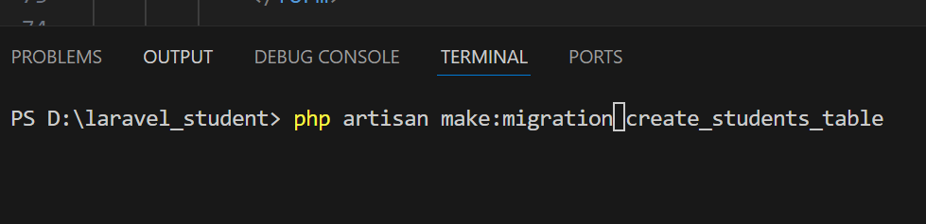
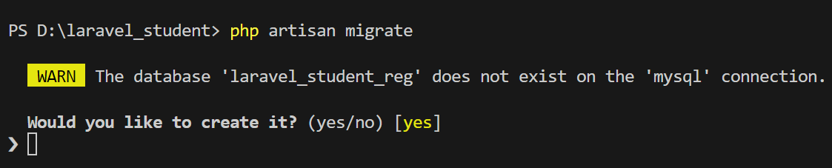
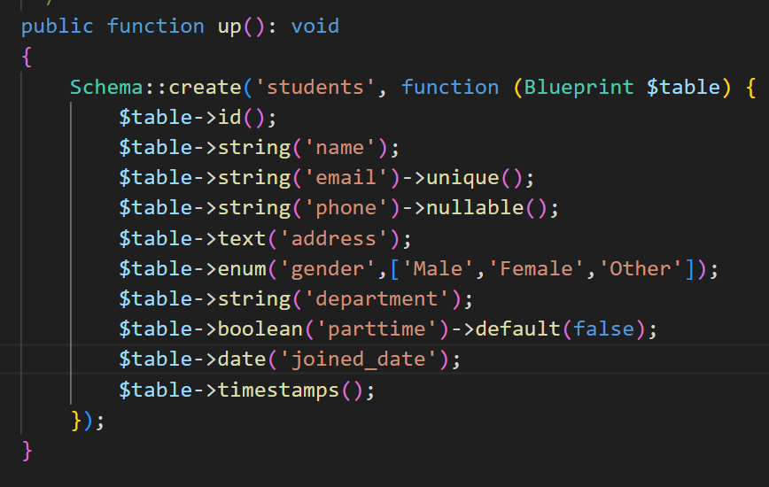
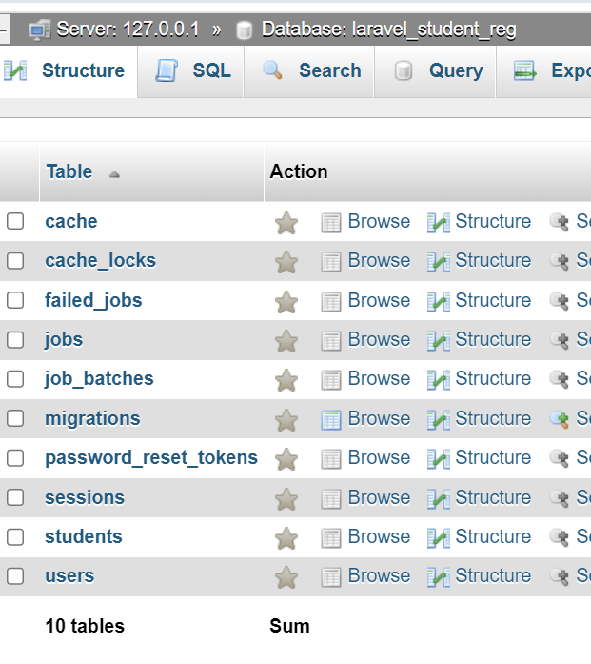
MIGRATION
Generate Migration
Generate Tables from migrations
Add Columns
Check Database for Tables

Slide 42
MODEL
Model
Student Model
Eloquent ORM
Eloquent ORM
Database Table
Students Table

Slide 43
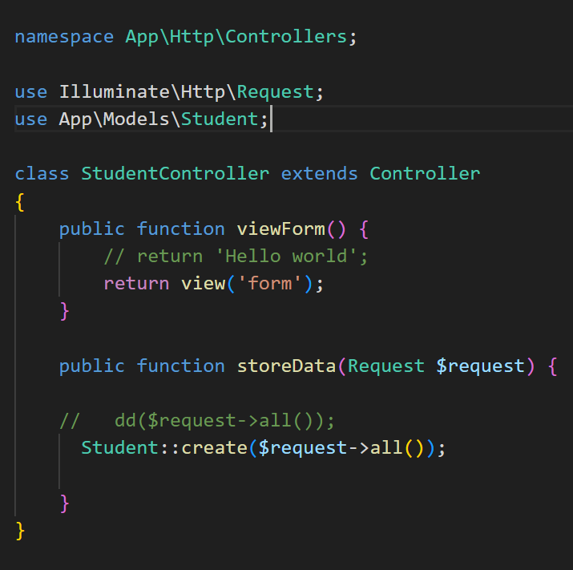
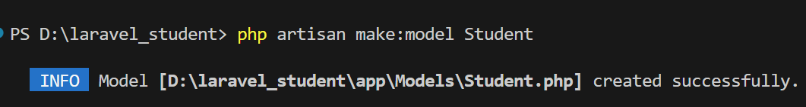
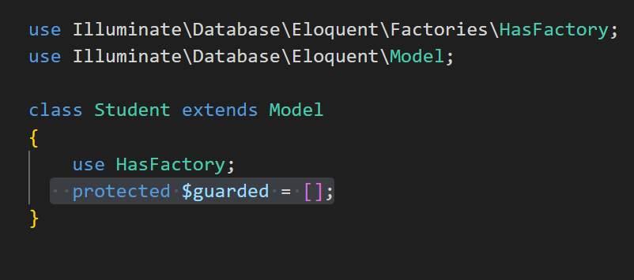
Store Data
Use Model to Create Table Data
using Request values
Create Model
Specify No Guard needed for any columns

Slide 44
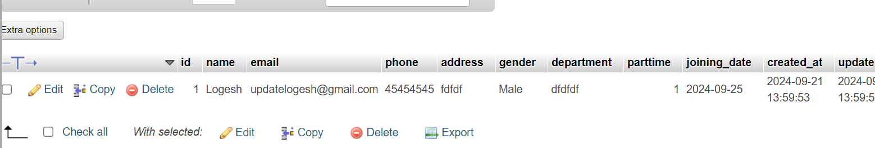
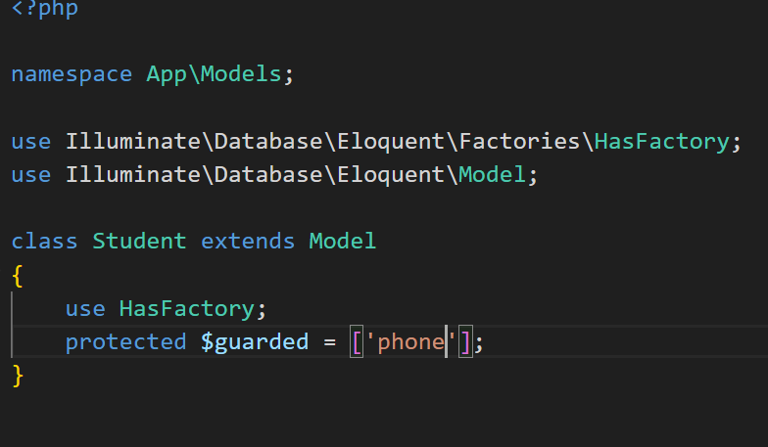
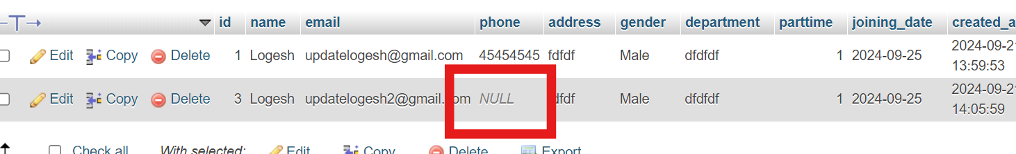
MODEL
Adding columns in guarded will not allow inserting values on that column
After Submitting Form It will insert

Slide 45
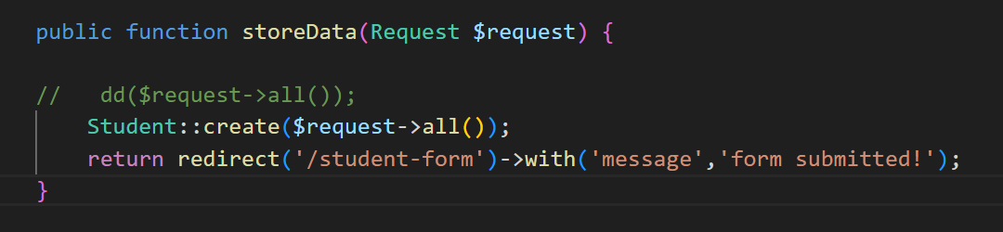
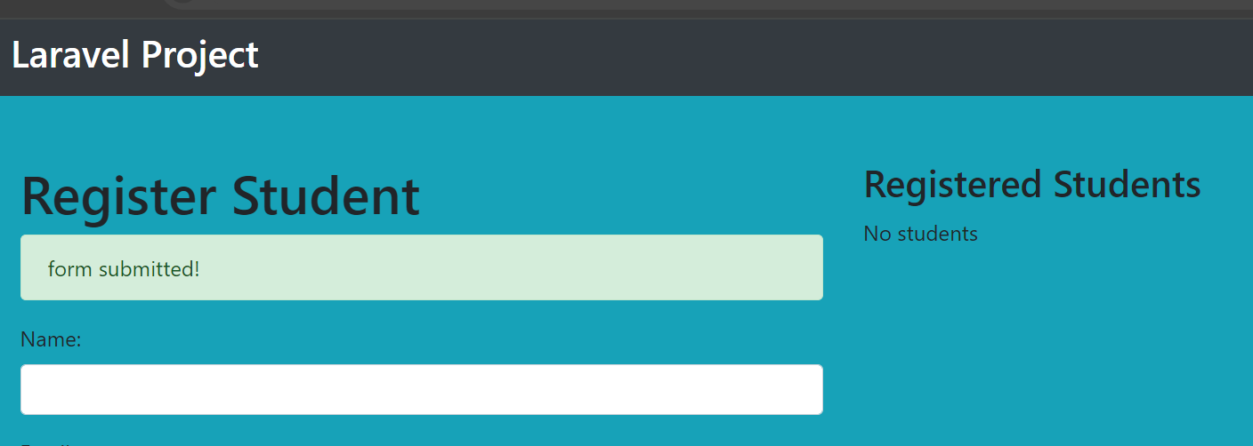
Redirect
Add Redirect to student form with success message

Slide 46
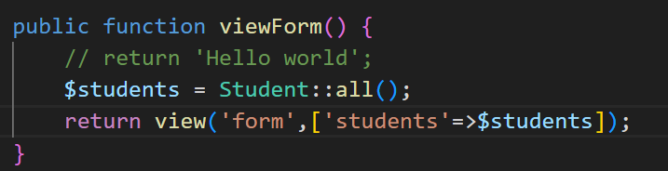
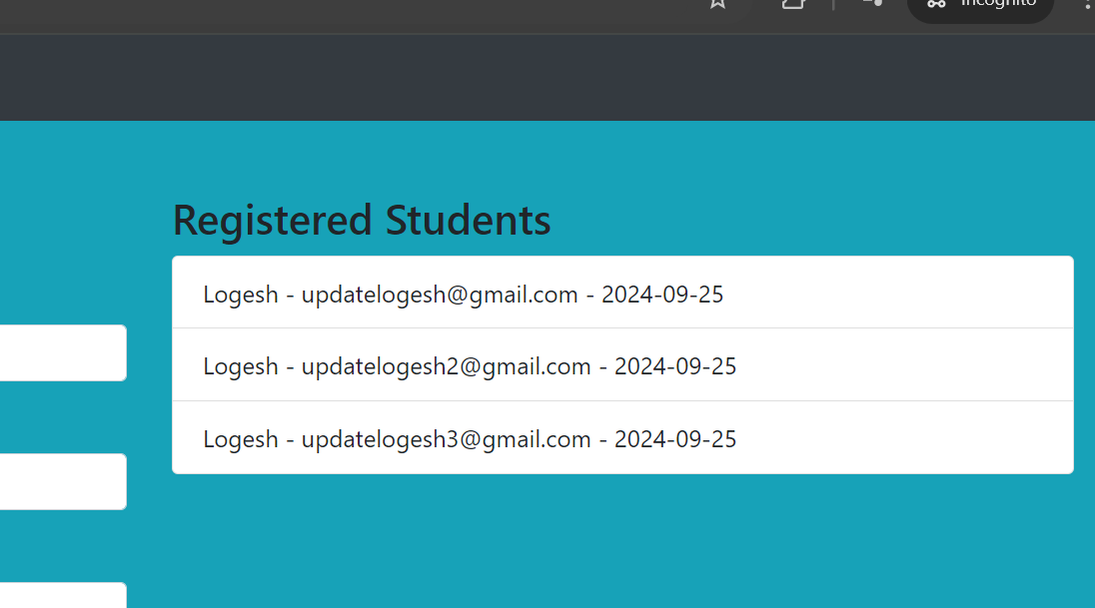
Student List
Add code for getting students list Pass it to view in viewForm
View result in the student form

Slide 47
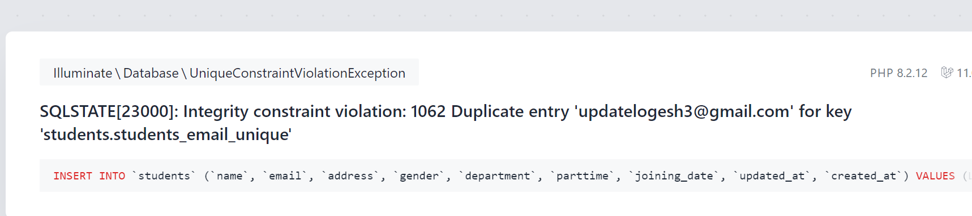
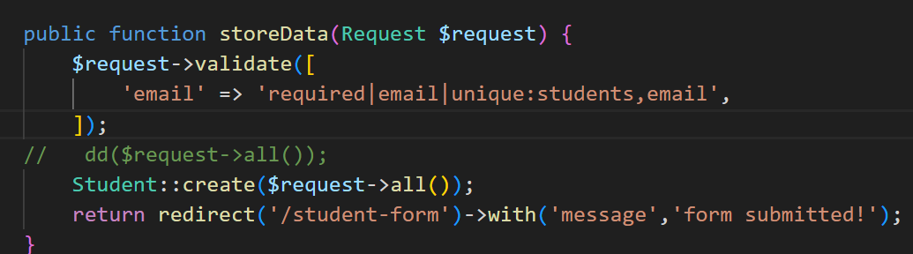
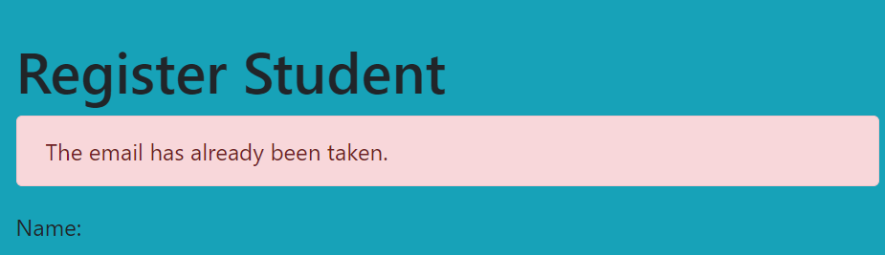
Validation

Slide 48
ROUTE URI CAN BE SAME
GET
Route
/students
Controller
StudentController.php
viewForm
http://127.0.0.1/students
POST
Route
/students
Controller
StudentController.php
storeData
http://127.0.0.1/students

Slide 49
REQUEST METHODS
GET
Retrieve Page or Data
POST
Submit Data
PUT
Update Data
DELETE
Delete Data

Slide 50
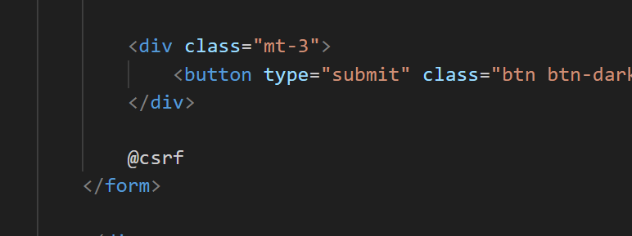

Understanding CSRF
Remove @csrf and submit
You will get 419 Expired Page. Means you cannot submit Request.

Slide 51

CSRF Token

Slide 52
POST ROUTE
FORM PAGE
Laravel App
POST
Route
/add-student
Controller
StudentController.php
addStudent
Form Submitted
CSRF TOKEN
Redirects to Form Page

Slide 53
Overview of Laravel (30 minutes)
Enjoy Coding!
Thanks!

